Slide 1
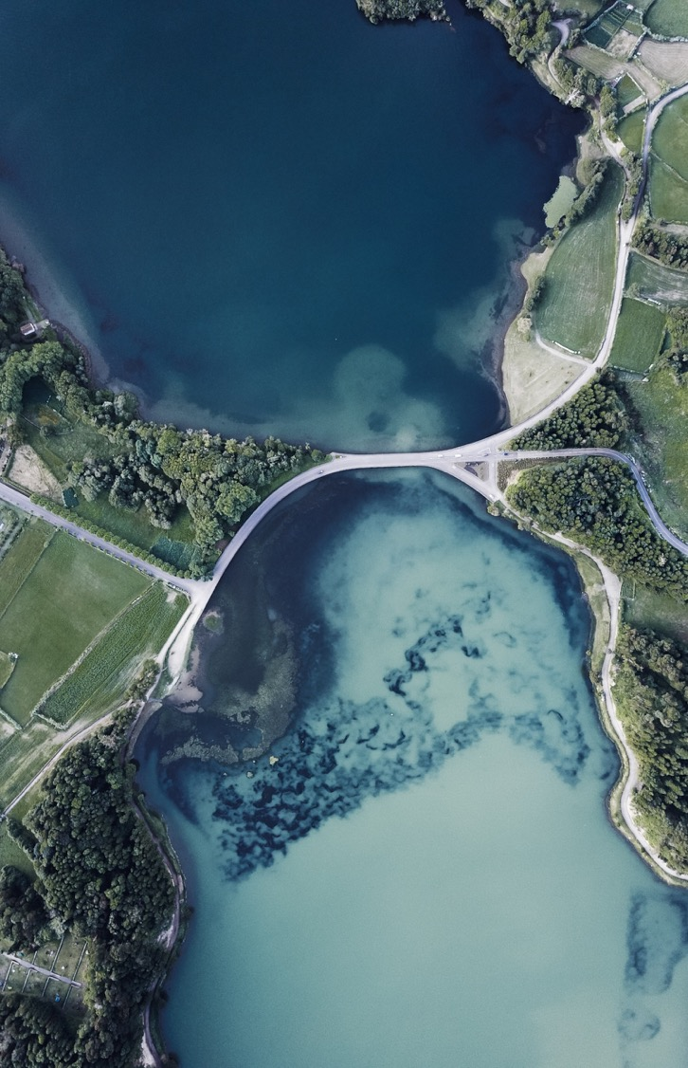
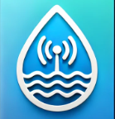
Real-time river monitor
-BlueGuardian
John, Wu

Slide 2
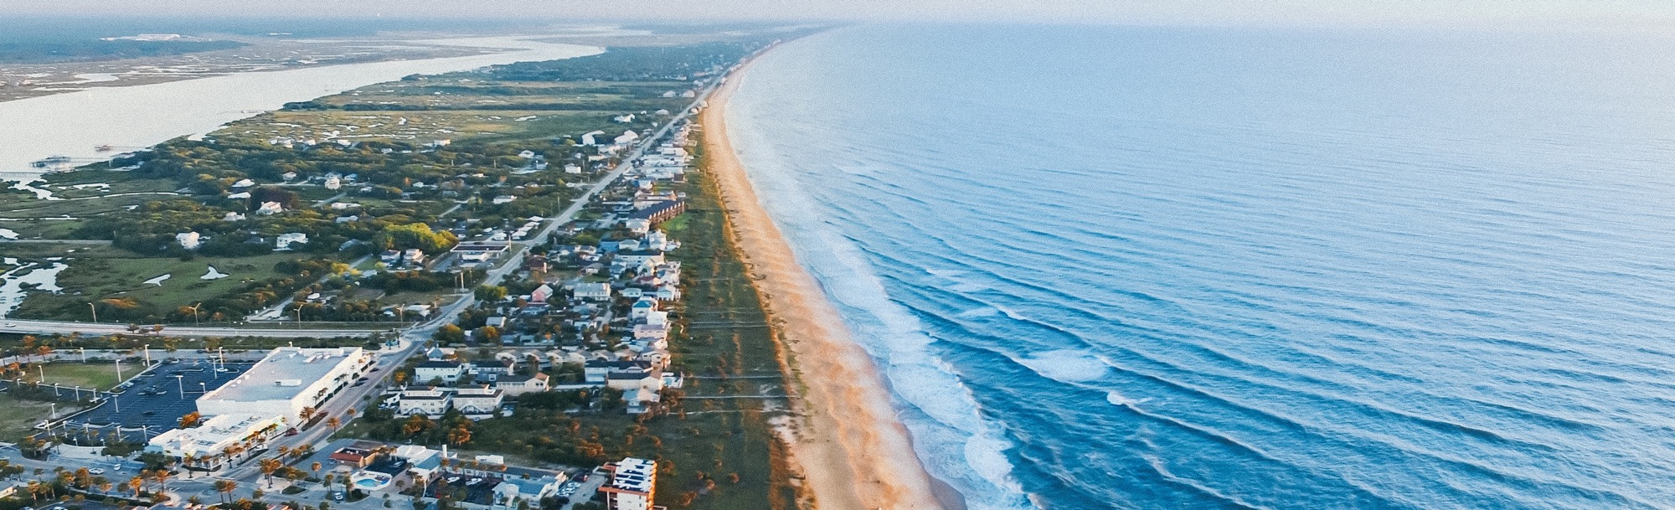
App overview
This Real-time River Monitoring App provides instant access to water quality data by integrating sensor networks. Users can monitor multiple rivers, view real-time quality status, and track sensor locations on an interactive map. The app displays live sensor data, including Coli, pH, and TDS, in both table and graph formats, with cloud-based connectivity ensuring real-time updates.
BlueGuardian

Slide 3
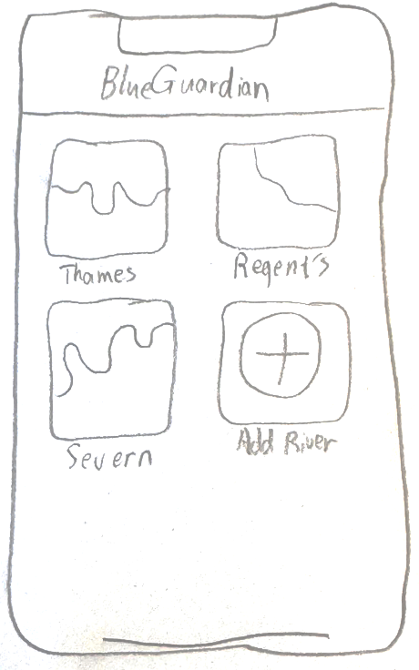
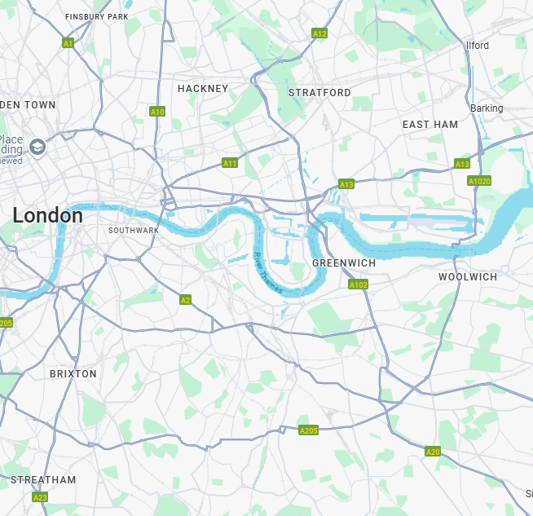
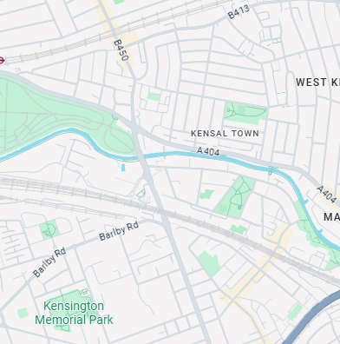
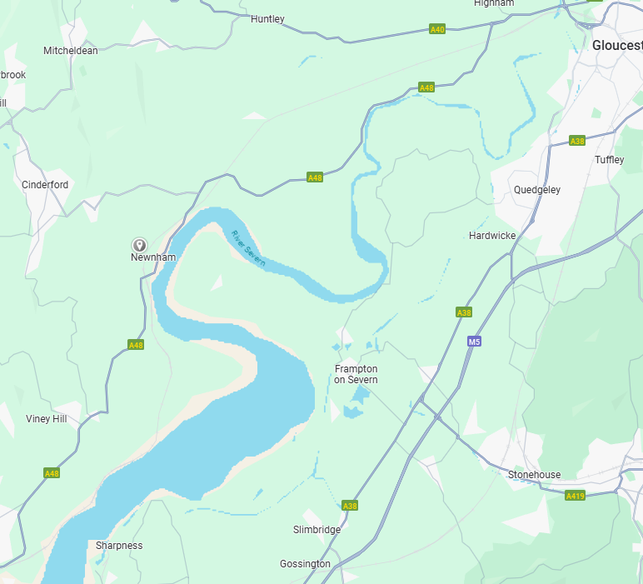
Homepage Design
Content:
Displays maps of the selected rivers.
Shows sensor locations on the river.
Water quality indicators (Good, Poor).
“Add More River” option.
BlueGuardian

Slide 4
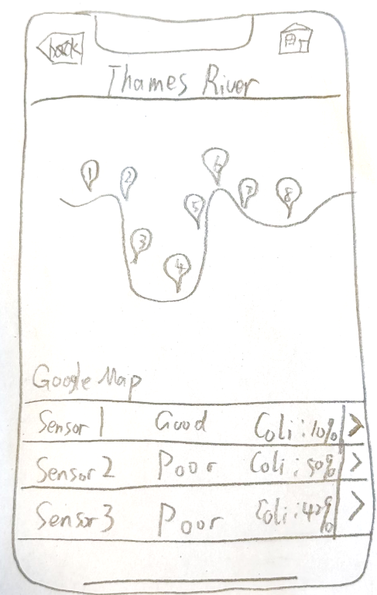
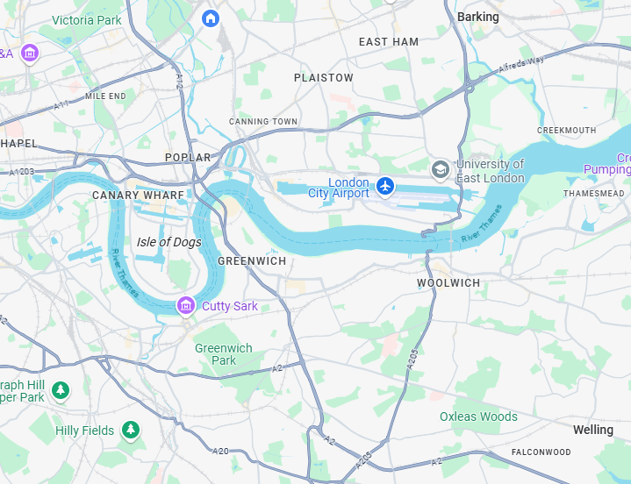
River Detail Page
Content:
Displays a map of the selected river.
Shows sensor locations on the river.
Bottom section lists real-time sensor readings.
Users can click on a sensor to view detailed data.
Navigation options: Back or Home
BlueGuardian

Slide 5
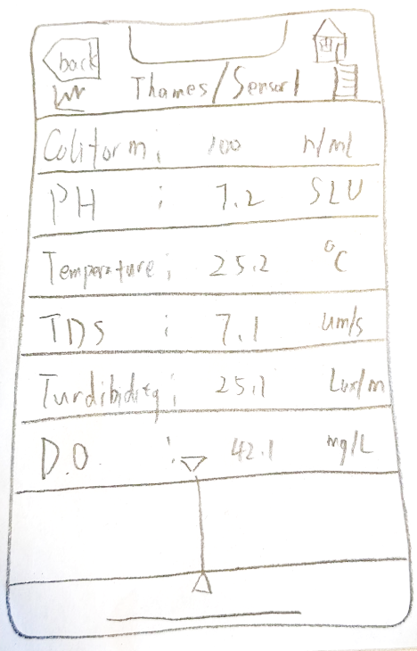

Sensor Detail Page
Content:
Users can switch between table view and graph view using two buttons.
Displays multiple sensor readings (e.g., Coli, pH).
A scrollable timeline at bottom to view history data.
Provides an intuitive interface for monitoring water quality trends.
BlueGuardian

Slide 6
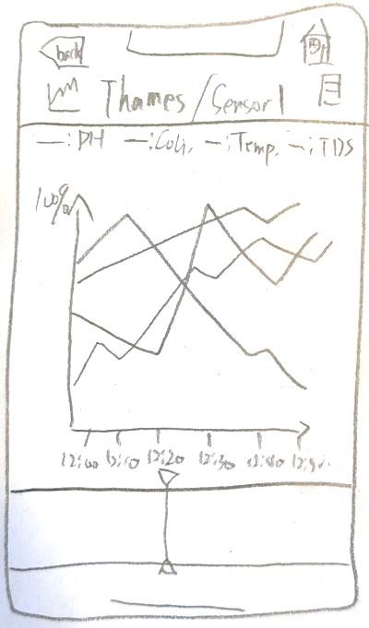
sensor graphic Page
Content:
Users can switch between table view and graph view using two buttons.
Displays multiple sensor graphic (e.g., Coli, pH).
A scrollable timeline at bottom to view history data.
Provides an intuitive interface for monitoring water quality trends.
BlueGuardian

Slide 7
Backend Data Flow
Data Collection
1. Data Collection
Monitoring stations collect raw analog data from sensors.
Pre-processing is performed to clean and format data.
2. Data Transmission
Processed data transmitted via LoRa to the central server.
3. Server Processing & Storage
A neural network predicts fecal contamination and E. coli levels, storing the results.
4. Data Distribution
Send processed and predicted data to the app via MQTT.
Data Transmission
Server Processing & Storage
Data Distribution
BlueGuardian

Slide 8

Thank you
zhuohang2024@163.com
Headmaster218/Thames-pollution-detect-IoT: Use inorganic sensors and Machine Learning to detect the wastes in rivers.

